Slide 1
The Functional Mock-up Interface 3.0 Beginners’ Tutorial

Slide 2
Agenda
Overall agenda
Times
Q&A after each sections
Intri
Motivation / History
How does FMI work?
Tool support
New features in FMI 3.0

Slide 3
Motivation, Timeline
“Why FMI”?
“And how did it develop”

Slide 4
Motivation
Define a tool-independent, free-to-use standard for exchange and co-simulation of models between different simulation tools
Provide models in a containerized form
Decouple Know-How between producers and users of FMUs
Decouple know-how between different brands engineers and software programmers
Massive Re-use of modelling investment
IP Protection

Slide 5
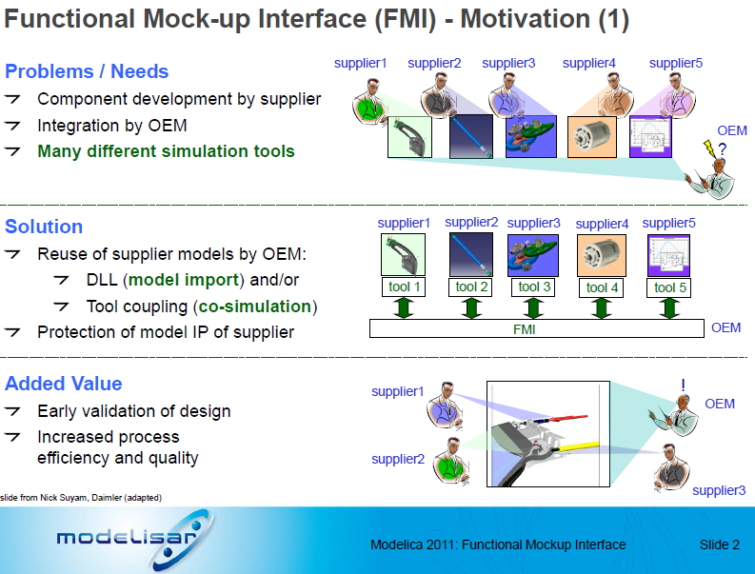

Timeline : Modelisar Project → Modelica Association Project FMI
FMI 1.0 (and most part of FMI 2.0) was developed in the publicly funded project Modelisar
2008-2011: MODELISAR project
2011: Release of FMI 1.0
2012: Foundation of MAP FMI as a project in the Modelica Associations
Members: see FMI Webpage
2013: Release of FMI 2.0 --> focus of this tutorial
2021: Release of FMI 3.0

Slide 6
Versioning of FMI
e.g. „FMI 2.0.4“
FMI uses semantic versioning:
Major releases
non backwards or forward compatible changes
Minor releases
Can introduce new features
FMI 3.1 is planned to be the first minor release
Backwards compatibility „FMI 3.0 will be valid FMI 3.1 FMUs“
Bugfix/Maintenance releases
No new features, only bugfixes and clarifications possible
Backwards and forward compatibility

Slide 7
FMI: Technical Fundamentals
“How does FMI work?”

Slide 8




































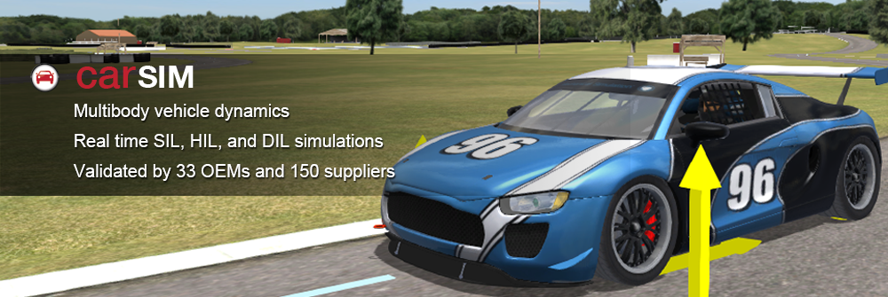















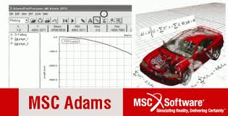







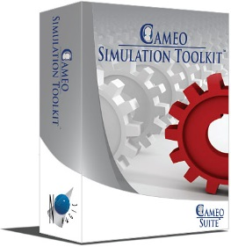

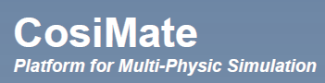

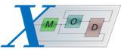






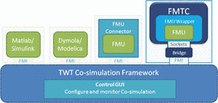



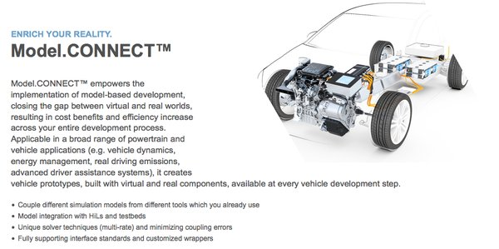


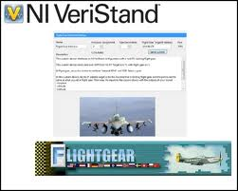



Exporting vs. importing tool
Remove icons
Exporting tool
Simplorer
Cruise
develop model
ASCMO
export as Functional Mockup Unit (FMU) accordingg to the FMI Standard
FMU SDK
FMI
import FMU
(co-)simulate model / run model somewhere else
Simplorer
INCA Flow
ModelFit
By TLK
COSYM
TLK TISC
VEOS
Silver
CarMaker®
Importing tool
The FMI standard decouples authoring and execution tool / toolchain / environment

Slide 9
The FMI standard
The FMI Standard defines the “Functional Mock-up Interface” FMI, an interface between a model and a simulation environment.
It consists of the definition of
a C-API (application programming interface)
an interface description (modelDescription.xml) according to a defined schema
the definition of an exchangeable unit, an “FMU” (Functional Mock-up Unit), technically a zip file

Slide 10
FMI deals with the interface and does not define a CS-Algorithm
the homepave.
(Sentence from the homepage)

Slide 11
Models in scope
Continuous system
ODEs, algebraic equations
Solver needed
Discrete parts
Notion of time (independent variable)
ODE: ordinary differential equations
Algebraic relations
Algorithms
Continuous vs. Discrete
ODE Solver

Slide 12
Co-Simulation
Co-Simulation: (from the FMI 3.0.1 glossary)
Coupling of several simulation programs in order to compute the global behavior of a system that consists of several subsystems.
Subsystems are coupled in the sense that the behavior of each subsystem depends on the behavior of the remaining subsystems, so that the co-simulation must be computed in a step-by-step fashion.
Each simulation program is responsible for computing the behavior of a subsystem, using the outputs produced by the other simulation programs.
There can be an additional error introduced by the co-simulation, that has to limited to an acceptable size by using a suitable co-simulation algorithms and communication pattern (e.g. step size)

Slide 13
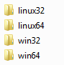
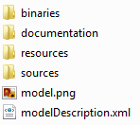
FMU – „Functional Mock-up Unit“
myModel.fmu
A model container, that can be distributed
Technically it is realized a zip File, with ending „.fmu“
Content:
modelDescripotion.xml: meta-data with information on the model variables, interface, capabilitis and to a limited extent model structure
Model representation
Binaries for one or multiple platforms and/or (“black box”)
Source code (e.g C-Code)
Optionally: Resources, documentation, Icons, port definitions
/extra information (defined in layered standards)
modelDescription.xml
model.dll

Slide 14


FMU for Model Exchange vs. Co-Simulation (FMI 2.0)
Model Exchange (ME)
Importing tool provides the solver.
Properties:
Very tight integration of model in simulation tool
Complex interface between importing tool and model
Importing tool must provide a suitable solver for the model
Used e.g. for inclusion of Modelica support in non-Modelica tools (using the solver of the the importing tool)
Co-Simulation (CS)
Exporting tool provides the solver.
Properties:
Tight coupling of model and a suitable solver
Simpler interface between importing tool and model
Freedom in the selection of a co-simulation algorithm and communication timestep to reach a stable and accurate solution
Used in most industrial applications
Tool
FMU
FMU
Tool
Solver
Model
Model
Solver

Slide 15
Co-Simulation calling sequence
Communication timestep can be different from internal steps (e.g. Variable step solver)
Calling sequence CS
Set inputs: fmi2SetXXX(...)
Trigger calculation until next communication point: fmi2doStep(...)
Get outputs: fmi2GetXXX(...)
For an implementation in C, see e.g. fmusimi in the Reference FMUs: https://github.com/modelica/Reference-FMUs/blob/main/fmusim/fmusim_fmi2_cs.c
You can view the calling sequence with fmusim --log-fmi-calls
Use 1.0 CS FMU Put the code there

Slide 16
ME
Idea: similar to S-Function
Expose RHS of the ODEs
Use 1.0 CS FMU Put the code there

Slide 17
FMI for Co-simulation Tool Wrapper Variant
Capabiltiy flag
Co-simulation stand-alone FMU
self-contained FMU
Co-simulation FMI Tool Wrapper
FMU dependent on an existing tool installation

Slide 18
FMI tool support
https://fmi-standard.org/tools/: FMI supported by >= 180 Tools
Exporting tools
Modeling and simulation tools
Model-based software creation
Wrapping of algorithms, virtual ECUs
…
Importing tools
Modeling and simulation tools
Co-simulation tools and integration platforms
Implementations for programming and scripting languages
….

Slide 19
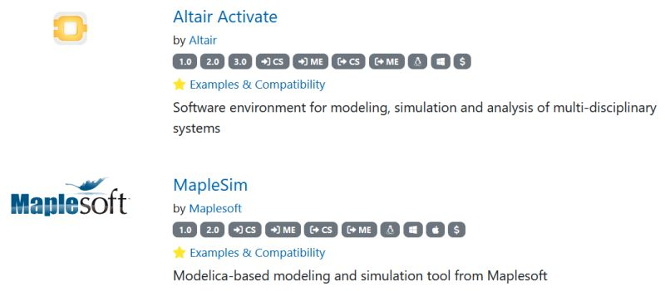
Compatibility information
Replaces the cross-check that helped to improve he maturity of FMI 1.0 and 2.0 supporting tools.
Information on on how FMI export and import have been tested provided by the tool vendors and linked in the tools list
Tools providing compatibility information are marked with a golden star and listed on top of the tools list https://fmi-standard.org/tools/:

Slide 20
Validation of FMUs

Slide 21
Licenses and licensing
License information in documentation folder
Not covered by FMI standard
Legal

Slide 22
New features with FMI 3.0

Slide 23
Motivation for FMI 3.0
180+ tools support FMI now: many users now, many new use-case requests:
Virtual Electronic Control Units (vECUs):
FMI 2.0 works well for physics simulations: better support for vECUs is needed
Advanced Co-Simulation
Co-Simulation is the more popular interface type: improved co-simulation methods are needed to improve performance and accuracy
Multi-FMU simulations are getting more common
Events are necessary in complex control systems
Events must be synchronized across FMUs
New ML and AI applications
More derivatives computations is required
vECU
Co-Sim
Events
AI
API Efficiencies

Slide 24
FMI 3.0: New Interface Type – Scheduled Execution
vECU
Events
FMI 2.0
Model Exchange
Co-Simulation
FMI 3.0
Model Exchange
Co-Simulation
Scheduled Execution
Scheduled Execution allows coupling several FMUs with one, external scheduler (OS)
Notes:
This is necessary for collaborative development of complex system controllers

Slide 25
FMI 3.0: Main Improvements
Performance
Accuracy
Event mode for Co-Simulation
Intermediate variable update
Clocks
New variable types
Array variables
Terminals and icon
FMI for Scheduled Execution (SE)
Preparation for layered Standards
New Application
Notes:
Show co-sim and intermediate output notebooks

Slide 26
Layered Standards
Extension mechanism ….

Slide 27
Resources
Linkd
FMI Webpage
FMI tools list
FMU validation
Reference FMUs, fmpy, Jupyter notebooks
(Unofficial) Stack overflow (tagged FMI)
(Unofficial) FMI LinkedIn Group

Slide 28
Example model for hands-on part

Slide 29
Example model: Controlled Motor Drive
Only slide
------------------
DEMO
------------------
Motor Drive with PI control –> FMU-Export
Model created in Modelica, with tool Dymola (also SimulationX, …)
Drive FMU
Overall FMU
Stimuli FMU
Desired torque
Step at time 0,1s
Control FMU
Load Step
at time 0,5s
Reference solution
Angular speed

Slide 30
Backup

Slide 31
FMI Standard & FMI support in tools
Modelica Association Project FMI
FMI Design Group Members
All members have signed the MAP FMI’s CCLA (corporate contributor license agreement)
FMI Standard
FMI specifications: CC-BY-SA 4.0 (Creative Common Attribution-ShareAlike 4.0 International)
Source code (C-header & XML-schema files): 2-Clause BSD License7
Layered Standards
(domain specific extensions ot the FMI Standard)
Tool Vendors
have freedom to choose their licensing model
FMU import / export might be free
FMU export might require a license FMU might require runtime license (FlexLMSee also
License conditions and legal aspects
Layered Standards
(domain specific extensions ot the FMI Standard

Slide 32
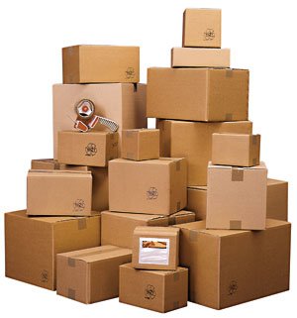
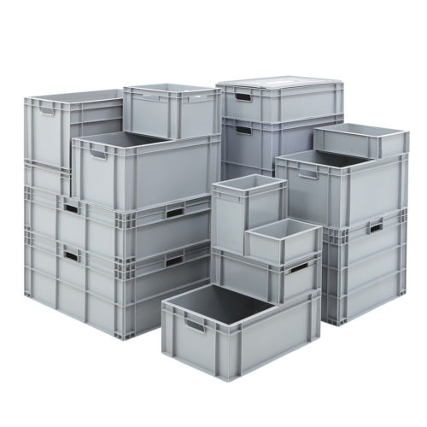
FMI: Simpler „Plumbing“ for Simulation
FMI for Model Exchange: How to connect systems of equations (ODEs)
FMI for Co-Simulation: How to connect “any” model or tool
Decouple Know-How between producers and users of FMUs
Decouple know-how between different brands engineers and software programmers
Massive Re-use of modelling investment
Many new use-cases are now viable
150+ tools now support FMI: See: fmi-standard.org/tools
https://fmi-standard.org/

Slide 33
FMU for Model Exchange vs. Co-Simulation (FMI 2.0)
Model Exchange (ME)
Importing tool provides the solver.
Pros:
Typically more stable as the solver gets direct access to the entire set of equations (internal modules and FMUs).
Cons:
Importing tool must have rich set of solvers that are able to properly handle the imported FMU (stiff, variable step size, event handling, parse,…).
Co-Simulation (CS)
Exporting tool provides the solver.
Pros:
Exporting tool can apply the most appropriate solver.
Typically faster for large systems.
Well suited for parallelization and multi-rate integration.
Cons:
Numerical stability cannot be guaranteed.
Performance depends on master algorithm (communication step size, events, interpolation).
Master algorithm depends on the maturity of the FMUs.
FMU
Tool
FMU
Tool
Model
Solver
Model
Solver

Slide 34
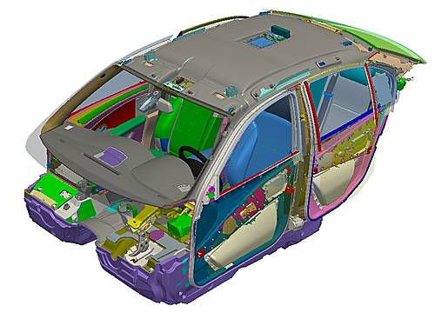
Motivation
Digital Mock-up (DMU) for packaging is state of the art in industry:
Suppliers deliver geometry of their components as CAD data
OEMs assemble them to the whole virtual system
Added value:
Check consistency of parts
Computation of design envelope
Evaluation of assemblability and disassemblability
How to include behavior in mockup?
Source: Teraport GmbH

Slide 35
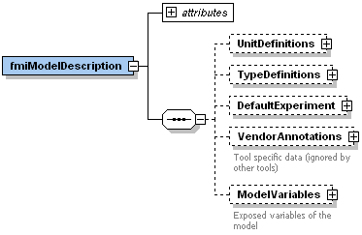
FMU Structure and Content
FMU implements FMI
FMU = .zip-file with renamed file extension
Must include modelDescription.xml (I/O description + some info)
Must include at least one binary representation or source code
Some optional content:
XML schema (.xsd)
defined by the
FMI specification
GUI
<<read>>
<<references>>
<<control>>
.fmu
Solver
1..*
model.dll
modelDescription.xml
<<run>>
Functional Mock-up Unit

Slide 36
History
The FMI 1.0 was developed in 2008-2011 by initiative of DAIMLER in the EU-0funded MODELISAR project with participation of OEMs, tool vendors and research institutes.
FMI defines an interface for the model exchange between different simulation tools and development partners (e.g., OEMs <-> supplier)

Slide 37
FMI: Technical Fundamentals
“How does FMI work?”

Slide 38
The FMI standard
The FMI Standard defines the “Functional Mock-up Interface” FMI, an interface between a model and a simulation environment.
It consists of
a C-API (application programming interface)
an interface description (modeldescription.xml) according to a defined schema
the definition of an exchangealble unit, an “FMU” (Functional Mock-up Unit), technically a zip file

Slide 39
FMU Structure and Content
FMU implements FMI
FMU = .zip-file with renamed file extension
Must include modelDescription.xml (I/O description + some info)
Must include at least one binary representation or source code
Some optional content:
XML schema (.xsd)
defined by the
FMI specification
GUI
<<read>>
<<references>>
<<control>>
.fmu
Solver
1..*
model.dll
modelDescription.xml
<<run>>
Functional Mock-up Unit

Slide 40
FMU for Model Exchange vs. Co-Simulation (FMI 2.0)
Model Exchange (ME)
Importing tool provides the solver.
Pros:
Typically more stable as the solver gets direct access to the entire set of equations (internal modules and FMUs).
Cons:
Importing tool must have rich set of solvers that are able to properly handle the imported FMU (stiff, variable step size, event handling, parse,…).
Co-Simulation (CS)
Exporting tool provides the solver.
Pros:
Exporting tool can apply the most appropriate solver.
Typically faster for large systems.
Well suited for parallelization and multi-rate integration.
Cons:
Numerical stability cannot be guaranteed.
Performance depends on master algorithm (communication step size, events, interpolation).
Master algorithm depends on the maturity of the FMUs.
FMU
Tool
FMU
Tool
Model
Solver
Model
Solver

Slide 41
Unterschied Schrittweite bei CS : Communication timestep, internal
Calling sequence CS
SetXX
doSTEP
GetXX
(Code von RefFMUs kopieren)
https://github.com/modelica/Reference-FMUs/blob/main/fmusim/fmusim_fmi2_cs.c
Set Input, doStep, Sample (get output)
Calling sequence fmusim --log-fmi-calls (verkürzen)

Slide 42
FMI for Co-simulation Tool Wrapper Variant
Co-simulation stand-alone FMU
self-contained FMU
Co-simulation FMI Tool Wrapper
FMU dependent on an existing tool installation

Slide 43
(Co-)Simulation of multiple FMUs
Exported by: Tool 1
Tool 2
Tool 3
Tool n
FMU
FMU
FMU
FMU
…
Functional Mock-up Interface
Numerical Solver (ME) or Co-Simulation Algorithm (CS)
or
Scheduler (SE)
Not defined by FMI!

Slide 44
Limitations of FMI
Properties of FMI
Black box
Loss of Information
Partitioning of overall system
IP protection (Intention of FMI) vs. need to reveal info for in-house application
Unstructured signal interface (only scalars; no physical connectors) 3.0
Unsorted list of parameters (no hierarchies/groupings; dependencies hidden) layered standard?
FMI addresses ‘only’ interface problem, not numerical problem
Partitioning of system numerically difficult for tight couplings
Coupling & master algorithms not defined
Importing / Exporting
Maturity of FMI support varies between importing and exporting tools.
If something goes wrong, then who is responsible the exported FMU, the importing tool, the combination?

Slide 45
ToDo
FMI and licenseing
Resources
FMI Checking

Slide 46
New in FMI 3.0

Slide 47
Motivation for FMI 3.0
170+ tools support FMI now: many users now, many new use-case requests:
Virtual Electronic Control Units (vECUs):
FMI 2.0 works well for physics simulations: better support for vECUs is needed
Advanced Co-Simulation
Co-Simulation is the more popular interface type: improved co-simulation methods are needed to improve performance and accuracy
Multi-FMU simulations are getting more common
Events are necessary in complex control systems
Events must be synchronized across FMUs
New ML and AI applications
More derivatives computations is required
vECU
Co-Sim
Events
AI
API Efficiencies

Slide 48
FMI 3.0: Main Improvements
Performance
Accuracy
Event mode for Co-Simulation
Intermediate variable update
Clocks
New variable types
Array variables
Terminals and icon
FMI for Scheduled Execution (SE)
Preparation for layered Standards
New Application
Notes:
Show co-sim and intermediate output notebooks

Slide 49
FMI 3.0: New Interface Type – Scheduled Execution
vECU
Events
FMI 2.0
Model Exchange
Co-Simulation
FMI 3.0
Model Exchange
Co-Simulation
Scheduled Execution
Eigenschaften: External Schduler
Scheduled Execution allows coupling several FMUs with one, external scheduler (OS)
Notes:
This is necessary for collaborative development of complex system controllers

Slide 50
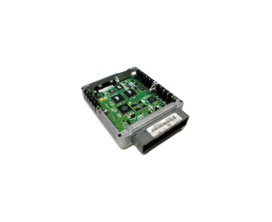
FMI 3.0: New Data Types
vECU
FMI 1.0, FMI 2.0 | FMI 3.0 | Remarks
fmiReal | fmi3Float32 | Discrete and continuous variables
 | fmi3Float64 | States, derivatives, event-indicators
fmiInteger | fmi3Int8, fmi3UInt8 | Discrete variables
 | fmi3Int16, fmi3UInt16
 | fmi3Int32, fmi3UInt32
 | fmi3Int64, fmi3UInt64
fmiBoolean | fmi3Boolean | char
fmiString | fmi3String | const char* ('\0' terminated, UTF-8 encoded)
 | fmi3Binary | const char* (e.g. sensor outputs, bitmaps, …)
 | fmi3Clock | Transport information about events
Notes:
Simple: these data types are used in real ECUs, having them in FMI enables realistic vECUs
Also: binary data for video, Lidar, radar, whever you want Modelica channel: tool demos

Slide 51
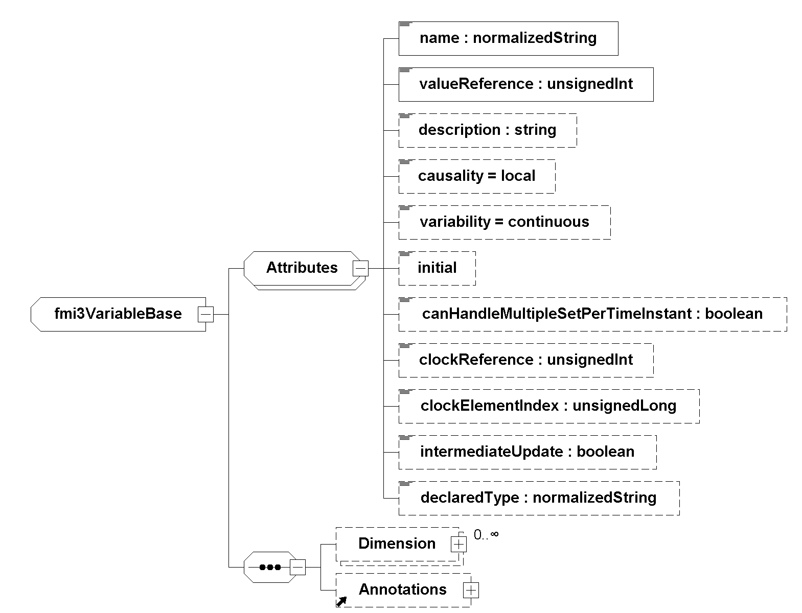
Array Variables (Vectors, Matrices, …)
vECU
FMI 1.0 and FMI 2.0:
Naming convention for array elements (building.room.temp[0], building.room.temp[1], …)
Array elements are treated as scalars, one valueReference for each variable
FMI 3.0:
Variables can have multiple <Dimension> elements
Each dimension can be:
Constant: specified by <start> attribute
Changeable: depends on a structural parameter which can change its value only in Configuration or Reconfiguration Mode
fmi3SetXXX, fmi3GetXXX work on whole arrays
API Efficiencies

Slide 52
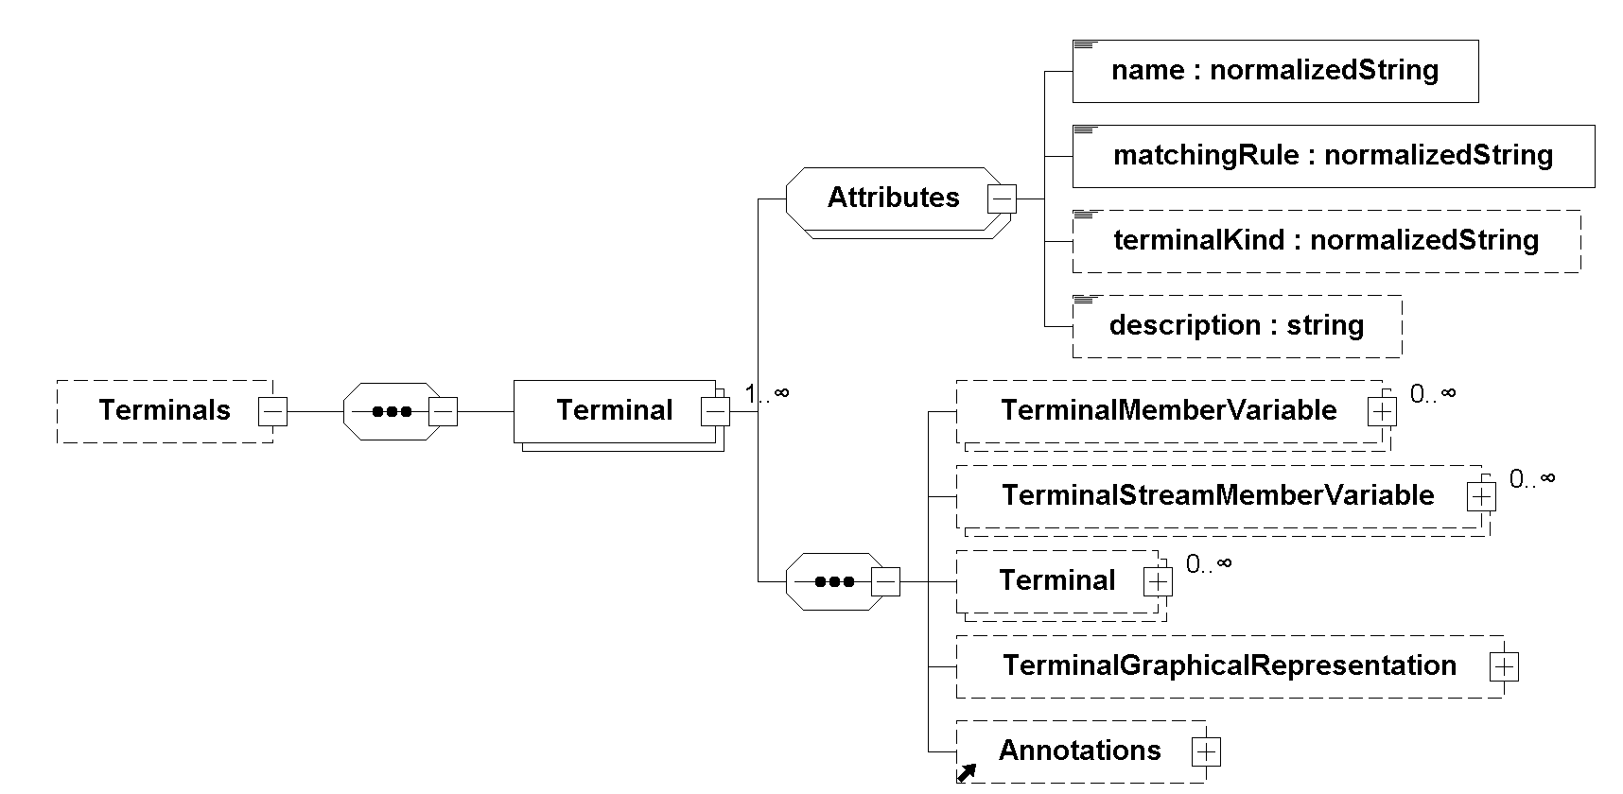
Terminals & Icons
Terminals group input and output variables to Terminals, which represent buses or physical connectors
Predefined matching rules (plug, bus, sequence) for the whole Terminal, other rules are possible
FMI Terminals are not acausal! The causality (input, output) is defined by the referenced variable!
Much improved UI: same structure & closer visual appearance to real system
Notes:
Use case: build UIs that reflect the structure of the physical system, or as in Modelica

Slide 53
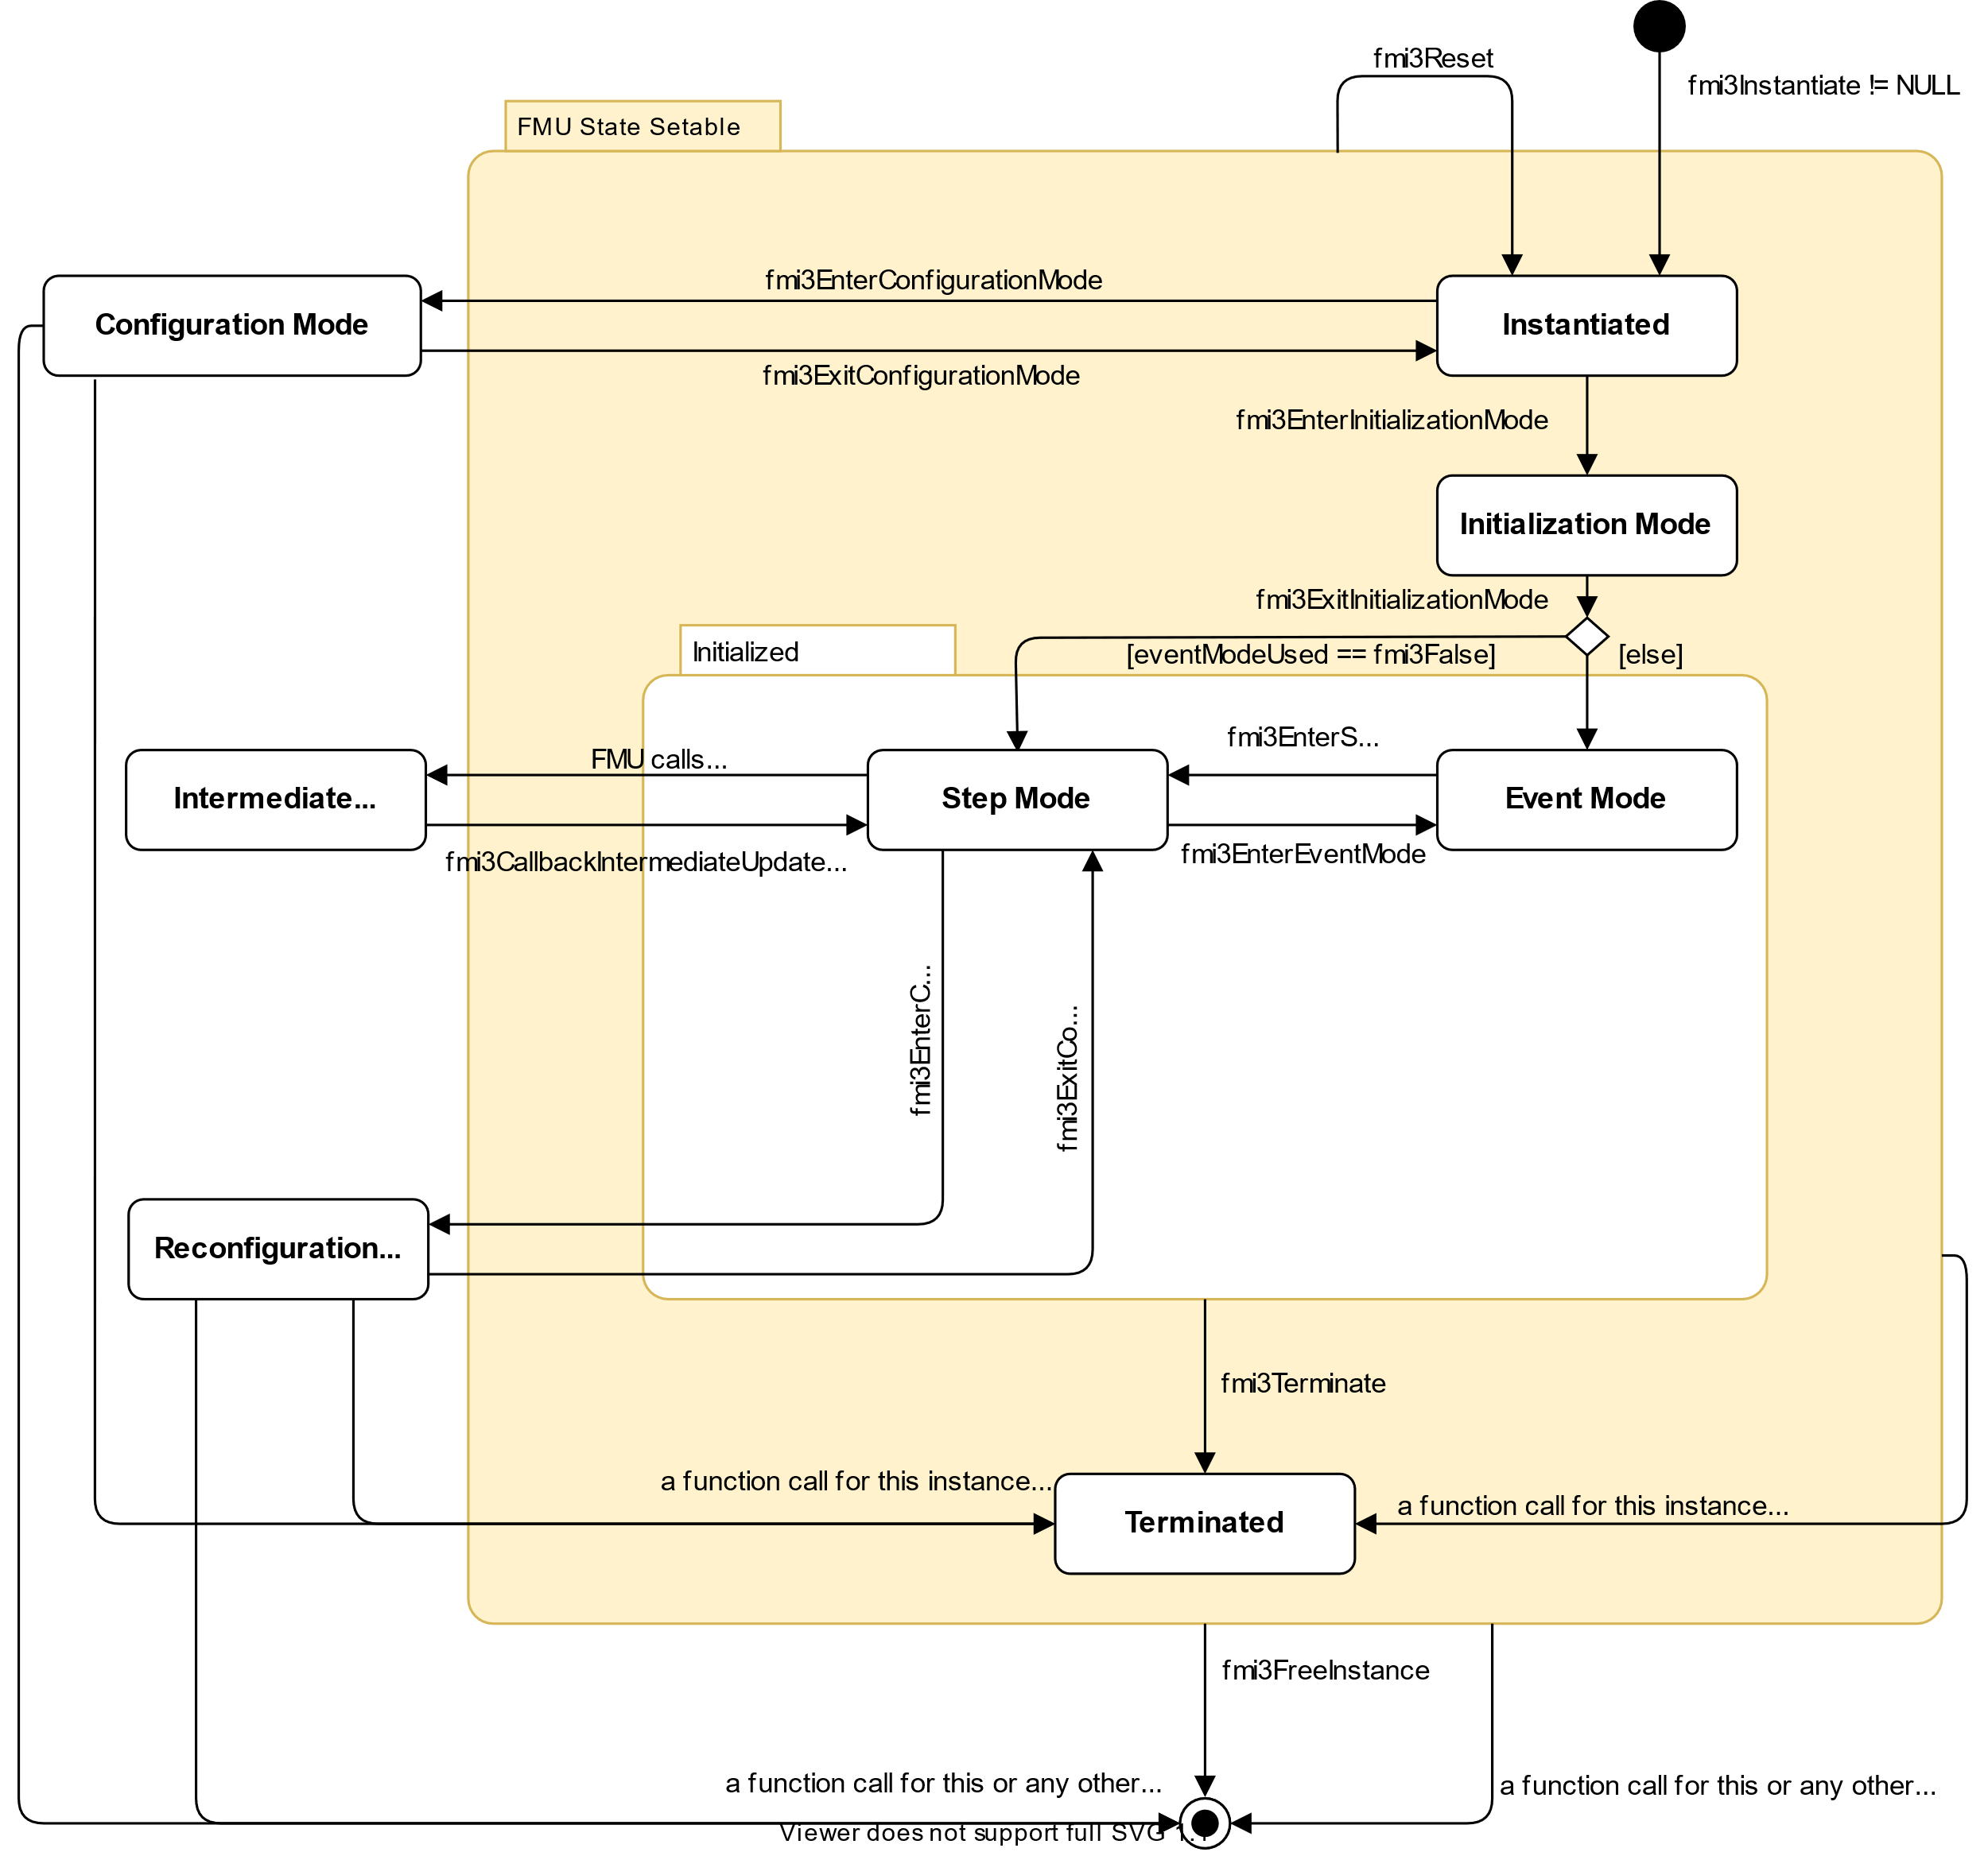
FMI for Co-Simulation: Event Handling
Co-Sim
Events
Introduction of Event Mode like in Model Exchange
Event Mode can be entered by the importer:
to handle input events triggered outside the FMU
on request of the FMU
fmi3DoStep(…) can return before communicationStepSize is reached if an FMU internal event needs to be treated outside
Capability flag hasEventMode signals if event handling is supported by the FMU
Argument eventModeUsed of fmi3InstantiateCoSimulation signals if event handling is supported by the importer
Demo in a Jupyter Notebook binder: Performance & Accuracy trade-offs, comparison FMI 2.0 vs. FMI 3.0

Slide 54
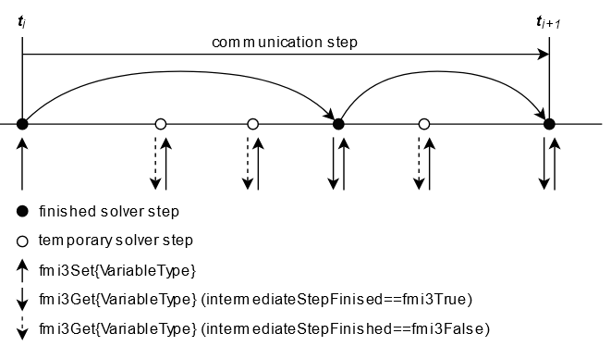
FMI for Co-Simulation: Intermediate Variable Access
Co-Sim
FMI1/2 CS: FMUs exchange values only at communication points.
FMI3.0: allows information exchange between the FMU and the master also at intermediate time points
Realized with an extension to the state machine: Intermediate update mode which can be entered by the FMU via the callback function fmi3CallbackIntermediateUpdate(…) at arbitrary times out of fmi3DoStep(…)
This enables various use cases:
Advanced co-simulation algorithms using interpolation / extrapolation techniques
Transmission Line Modeling (TLM) co-simulation
Input approximation similar to what is possible in FMI 2.0
More detailed plotting of simulation results (using additional time point)
Demo in a Jupyter Notebook binder: Performance & Accuracy trade-offs, comparison FMI 2.0 vs. FMI 3.0

Slide 55
Clocks
vECU
Co-Sim
Events
Clocks synchronize FMUs with the importer and with other FMUs:
Clocks carry the information that a specific event happens
Clocked variables belong to one clock (a so-called clocked model partition). They change only if this clock is active.
Clocks allow precise handling of time events (independent from continuous time: fmi3SetTime(), or arguments of fmi3DoStep())
In Scheduled Execution Communication Clocks are used:
by the importer to identify the specific partition which is to be executed
by the FMU to announce, which model partition wants to be scheduled

Slide 56
Clock Types
vECU
Co-Sim
Clock Type |  | causality | interval | Example
Time-based | periodic clock | input | constant | Clocked PI-controller with a defined constant interval
 |  |  | fixed | Clocked PI-controller, interval is defined by periodic fmi3SetClock calls
 |  |  | calculated | Clocked PI-controller, interval is defined by fixed parameter(s) of the FMU
 |  |  | tunable | Clocked PI-controller, interval is defined by tuneable parameter(s) of the FMU
 | aperiodic clock | input | changing | Simulation of the behaviour of a control algorithm with non constant execution time, Generation of pulse sequences
 |  |  | countdown | Time delayed action after an event, for example ignition signal some time after crankshaft angle event
Triggered |  | input | triggered | Control algorithm, triggered by a crankshaft angle sensor
 |  | output | triggered | Crankshaft angle sensor which ticks several times per revolution
Events

Slide 57
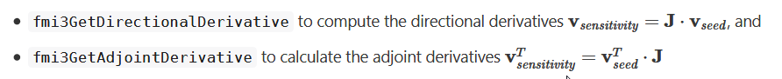
Adjoint Derivatives
AI
In several applications, including backpropagation for gradient-based training AI models, adjoint derivatives (“vector gradient products" (VJPs)) are needed
They can be implemented efficiently using revers mode automatic differentiation (AD)
FMI 3.0 provides now two access functions for partial derivatives:
Benefit:
This will allow to more efficiently encapsulate and train AI models with FMI
Connection of the Python/Julia tool world of AI to the system simulation world
Enabling the combination of physics-based and AI-based models (e.g. neural ODEs) and training in a unified framework

Slide 58
Concept of Layered Standard
vECU
The layered standard concept allows the specification of standards on top of FMI
XML element annotations and strings allow additional semantic for variables and terminals
Extra folder in FMU zip-file allows shipping of additional files at a well-defined place without disturbing compatibility
Examples:
XCP: When packaging virtual electronic control units (vECUs), XCP allows standardized access (see ASAM) to ECU internal variables (in preparation on FMI GitHub)
Network2Signals: Allows grouping and description of FMU inputs and outputs as network signals (in preparation on FMI GitHub)
Including of 3D-Visualization to FMUs which represent multi body simulation models (prototype from ESI ITI and TU Dresden)
Notes:
Demo available. Not necessarily important to show.

Slide 59
Miscellaneous
Graphical representations for the whole FMU and for Terminals can be defined (Icons)
Alias variable names are now specified by a list of alias names for each variable and no longer by a separate variable with the same valueReference.
Dependencies might change at runtime due to variable structure of the model or due to changes of array sizes. Dependencies for (array) variables can now be retrieved at runtime.
Asynchronous execution of fmi2DoStep was removed for simplification. This feature was never used and can be implemented by the importer.
Improvement and clarification of source code FMUs for better platform independency.

Slide 60
https://fmi-standard.org/tools/
Kategorisierung von tools import / import

Slide 61
Compatibility information
Replaces cross-check

Slide 62
Licenses ..
Not covered by FMI standard
Enforcement
Legal

Slide 63
Resources:
Main website: https://fmi-standard.org/
Development process can be tracked on GitHub: https://github.com/modelica/fmi-standard
FMI Layered Standards: https://github.com/modelica/fmi-ls-xcp; https://github.com/modelica/fmi-ls-bus
FMPy is permanently updated to support FMI 3.0: https://github.com/CATIA-Systems/FMPy
Reference FMUs: https://github.com/modelica/Reference-FMUs

Slide 64
Example model: Controlled Motor Drive
------------------
DEMO
------------------
Motor Drive with PI control –> FMU-Export
Model created in Modelica, with tool Dymola (also SimulationX, …)
Drive FMU
Overall FMU
Stimuli FMU
Desired torque
Step at time 0,1s
Control FMU
Load Step
at time 0,5s
Reference solution
Angular speed

Slide 65
More information
Web site: https://fmi-standard.org
Tool list: https://fmi-standard.org/tools/
Ask your tool vendors!
Publications: https://fmi-standard.org/literature/
Open-source tool kits:
Many more use cases:
Reference FMUs: more example FMUs
FMPy: Python integration, validation
FMI Example notebooks
Links

